Slide 1
Chapter 4
Welding
Visit for more Learning Resources

Slide 2
CO
Identify joining methods for fabrications, and fabricate simple job using joining method.

Slide 3
Welding
Welding is metallurgical fusion process,where part to be joined by the application of heat and pressure.
It is used to join the two different parts.
It is commonly used in the industries.
Advantages.
It is used for repair work.
Strength of joint is good.
They have high corrosion resistance.
Welding is used for fluid tight joints.
Different types of joints can be done.
Welding is economical and cost efficient.

Slide 4
Two Categories of Welding Processes
Fusion welding - coalescence is accomplished by melting the two parts to be joined, in some cases adding filler metal to the joint
Examples: arc welding, resistance spot welding, oxyfuel gas welding
Solid state welding - heat and/or pressure are used to achieve coalescence, but no melting of base metals occurs and no filler metal is added
Examples: forge welding, diffusion welding, friction welding

Slide 5
Welding
Disadvantages.
It produce harmful radiations.
It produce internal stresses distortion and change in micro structure in welding region.
Previous badge preparation requires.
Require skilled operator.
Applications.
Automobile parts.
Aircraft and ship construction.
Machine frames.
Pipelines.
Tanks and vessels.

Slide 6
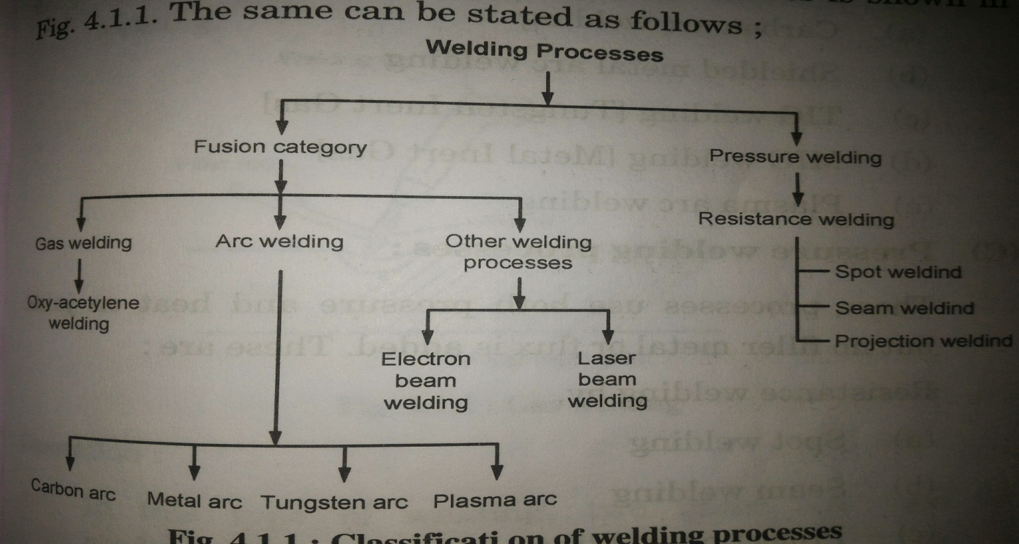
Welding classifications

Slide 7
Welding Classification
Gas arc welding.
Air acetylene welding.
Oxyacetylene welding.
Pressure gas welding.
Arc welding.
Carbon arc welding.
Shielded metal arc welding.
TIG welding.
MIG welding.
Plasma arc welding

Slide 8
Welding classification
Pressure welding process
Process requires both heat and pressure for joining. It does not require filler metal.
Spot welding.
Seam welding.
Projection welding.
Other fusion process.
Electron beam welding.
Laser beam welding.

Slide 9
Acetylene gas welding
In this process oxygen and acetylene gas is used for welding process.
It rises the temperature of metal above melting point.
Filler material is used for joining.
Operation
In this process oxygen and acetylene is used for the welding.
Oxygen supports the combustion and acetylene gas generate high temp.
Operation starts with placing the part togather which is to be join.
Oxiacetylene flame heat the metal temp produced is about 3200°c.
Filler metal is added to the join which join the parts by melting it self.
filler material is copper coated steel, carbon steel.
chemical reaction at tip is as followed.
2C²H²+5O²→4CO²+2H²O

Slide 10
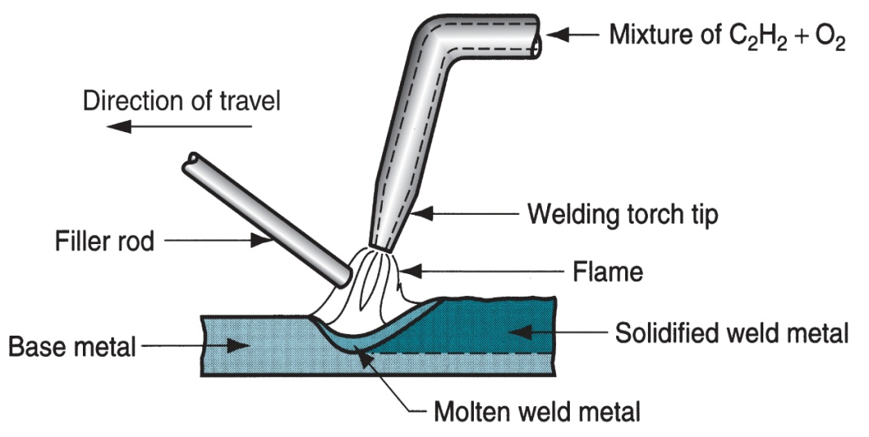
WELDING PROCESSES
Advantages.
It is used for all types of joints.
Oxyacetylene flame can be easily controlled.
Suitable for thin metal sheets.
Equipment is portable & versatile.
Limitations.
Method is slower.
Distortion of workpiece is more.

Slide 11
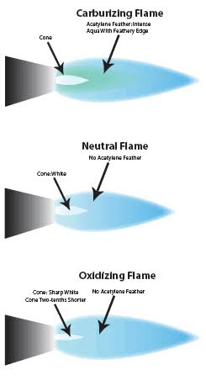
Types of flames
Natural flame.
All gas is burn
gives 100% heat.
Ideal flame used in gas welding.
Reducing flame.
It consist of inner core intermediate feather and outer flame.
It is also called as carburising flame.
strong reduction in higher zone due to high amount of acetylene .
Oxidizing flame.
It contain more oxygen than any other flame.
This is used for oxidizing metal like brass,Zink etc.
It is similar to natural flame.

Slide 12
Arc welding
In this process heat generation takes place by an electric arc.
Both work piece and electrod is connected to different terminals of AC or DC supply.
small gap bet work piece and electrod arc is generated.
It produces temp about 3600°c.
It having following types.
Carbon Arc welding.
Shielded metal arc welding.
Gas shielded arc welding.
Plasma arc welding.

Slide 13
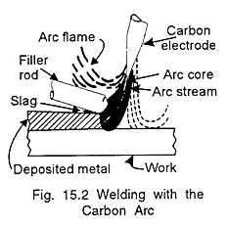
Carbon arc welding
It is new welding process.
Electric is made of carbon.
Electrics are soft and not suitable for high temp.
Electric consumption slowly & requires filler material.
Arc is generated between electrode and w/p.
DC supply is used Electrode is negative & w/p is positive.
It is used for thick material.

Slide 14
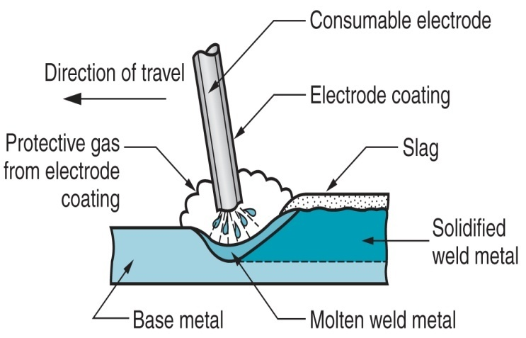
Shielded metal arc welding
In this electric arc is used for the welding purpose.
flux coated electrod is used for the welding.
flux gives stability to protection to weld metal.
during welding electrod is melt and serve as filler material.
flux over the electrode is also get melt to form coating over the weld material.Advantages.
Simple process.
welding equipments are portable and less costly.
Metal and alloy can be welded.
Applicable in any position.
Disadvantages.
Automatic welding is difficult because of short electrod.
Process is slow.
Welding defects are more during replacement of electrod.

Slide 15
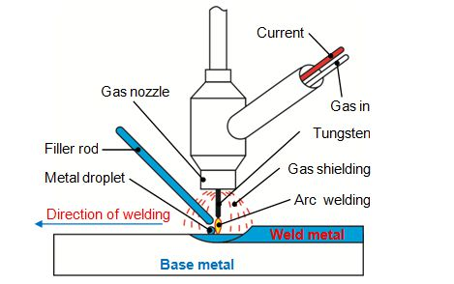
Tungsten inert gas welding(TIG)
It is also called as gas tungsten arc welding.
inert gas is act as shield and keep contaminant away from welded metal.
Electrod does not melt during welding.it is non consumable electrod.
filler material added separately.
Inert gas used is argon.
Advantages.
Slag free operation due to absence of flux.
different materials can be welded.
no cleaning requires.
Disadvantages.
Equipment cost is high.
slow process.
Filler material requires

Slide 16
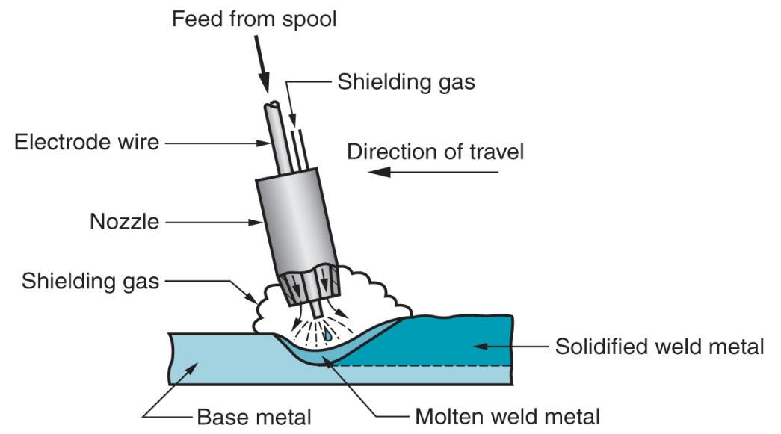
Metal inert gas welding (MIG)
It is also known as Gas metal arc welding (GMAW).
In this process weld joint is produced by heating the metal with electric arc.
The filling wire is continuously feed from wire reel at constant rate.
wire is feed though the rollers at constant rate.
Instead of flux ineart gas is supplied through welding torch.
welding torch is connected to cylinder of unwary gas like argon
Advantages.
slag inclusion are not occurs.
Continuous feed makes process faster.
Less skilled operator is required.
thick sheets can be welded.

Slide 17
Disadvantages.
Process is complicated.
setup is complicated.
Initial cost is high..
Applications.
For welding of commercial
metals like Nickel,killed steel.

Slide 18
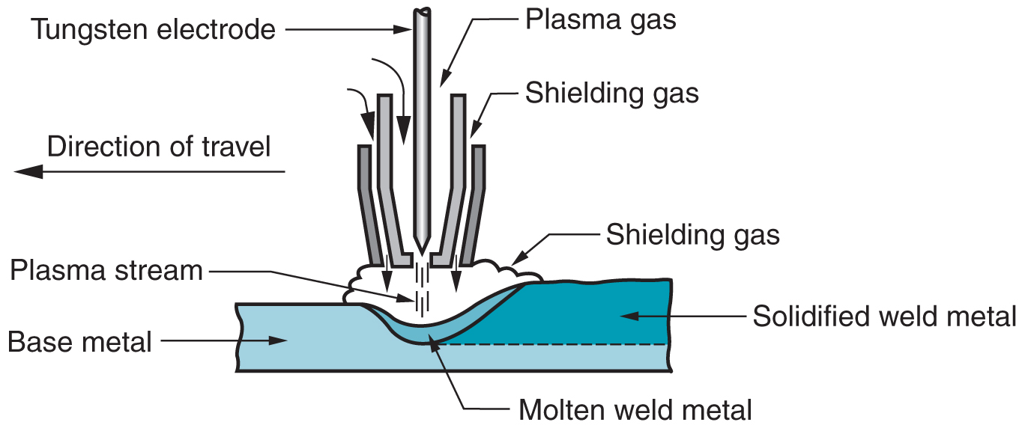
Plasma arc welding
Plasma is heated ionized gas enable it to conduct electric current.
Plasma arc is narrow restricted electric arc passes through water cooler orifice.
It consist of non consumable tungsten electrod and shielding gas like argon.
Argon gas flows through the orifice to form plasma.
the temperature of plasma is about 10000°c.
Advantages.
Weld uniform throughout.
greater depth of welding with less distortion.
proper control on heat.
metal disposition rate is high.

Slide 19
Plasma arc welding
Limitations.
Welding equipments are expensive.
frequent replacement of nozzle.
Applications
Stainless steel welding.
Nickel alloy in aero plane.
Aluminium or graphite nozzles for rocket

Slide 20
Resistance welding
In these process heat and pressure is applied on joint.
No additional filler or flux material required.
joint is obtained by means of electrical resisitance.
During process heavy current about 15000A is passed over joint with limited
area for short time.
Heavy current heat joint up to plastic state.
due to high pressure metal get fused and forms joint.
Heat generated is given as bellow H= CI2Rt
It is classified as
Spot Welding
Seam Welding
Projection welding
Upset Welding

Slide 21
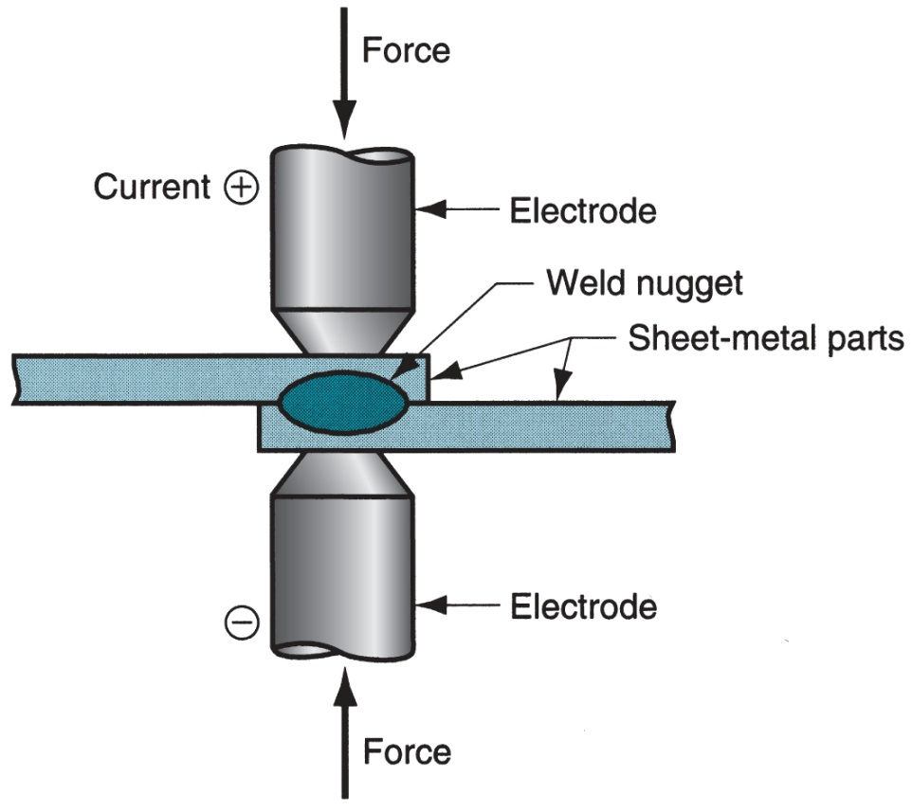
Spot Welding
It is first type of resistance welding and widely used for lap joint of thin metal sheet.
It is consist of two electrodes in which bottom electrode is fixed and upper is used for apply pressure.
Sheets to be weld are kept in the two electrode .
The pressure is applied over the sheets and current is passed though it so that they
get weld.
Welding is done due to high current is passed through the metal plates which produce heat.
Applications
For mass production.
For Ferrous and Non ferrous metals.
Used to weld sheets of 10mm thick

Slide 22
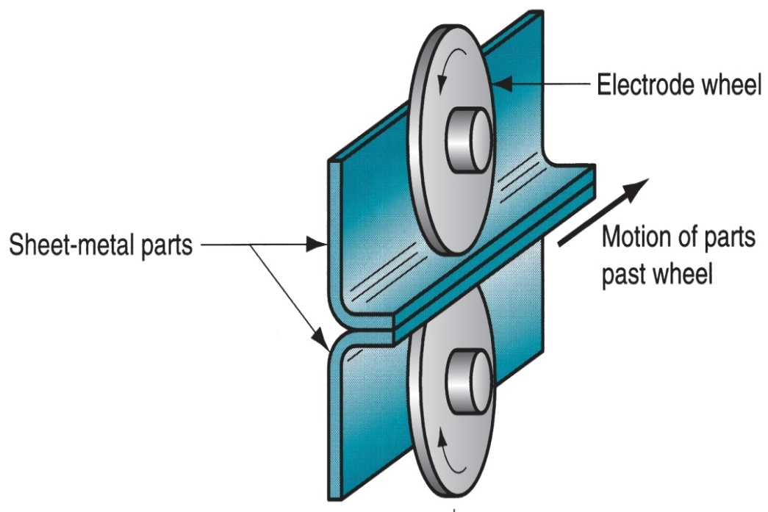
Seam Welding
It is used for special purpose
In this process disk type electrodes are used.
It is used to produce continuous type of welding between two sheets.
Disk are made up of cupper and current is applied through it
Current is applied in pulse form with proper time interval
Disks are rotate continuously so that metal sheets moves forward.
Current can be regulated by timer to produce continuous seam.
Applications.
For gas or water tight joints
To manufacture seam welded pipes

Slide 23
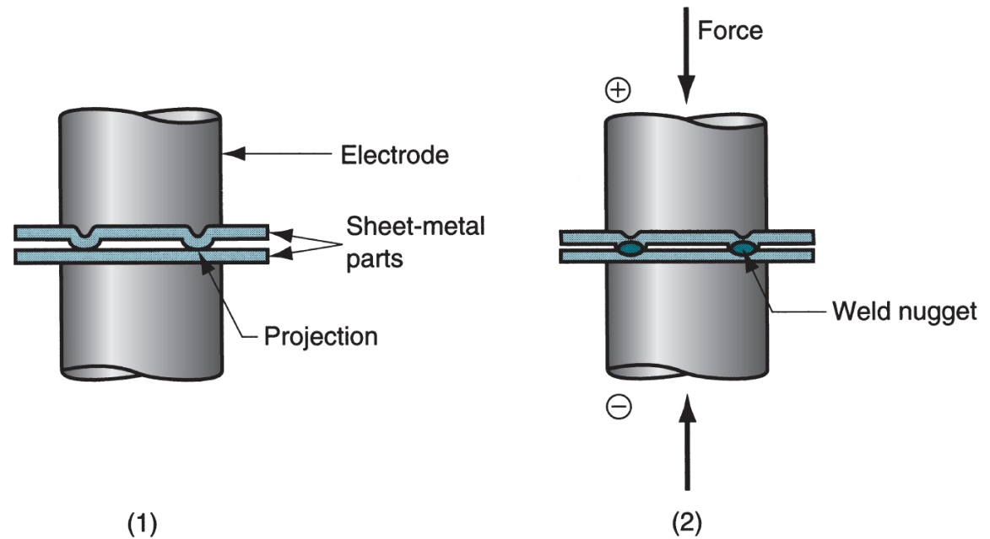
Projection Welding
It is modification of spot welding.
In this type one of the sheet is provided with projections and other is plane.
These projections are in circular form.
There diameter is equal to thickness of plate.
Current and pressure is get concentrated at projection areas during process.
During this process sheets to welded are kept between electrodes which made of cupper .
Pressure is applied by upper
movable electrode and lower
is fixed .
By passing current these
projections are get melted and
welding is done.
For more detail contact us

